Slide 1
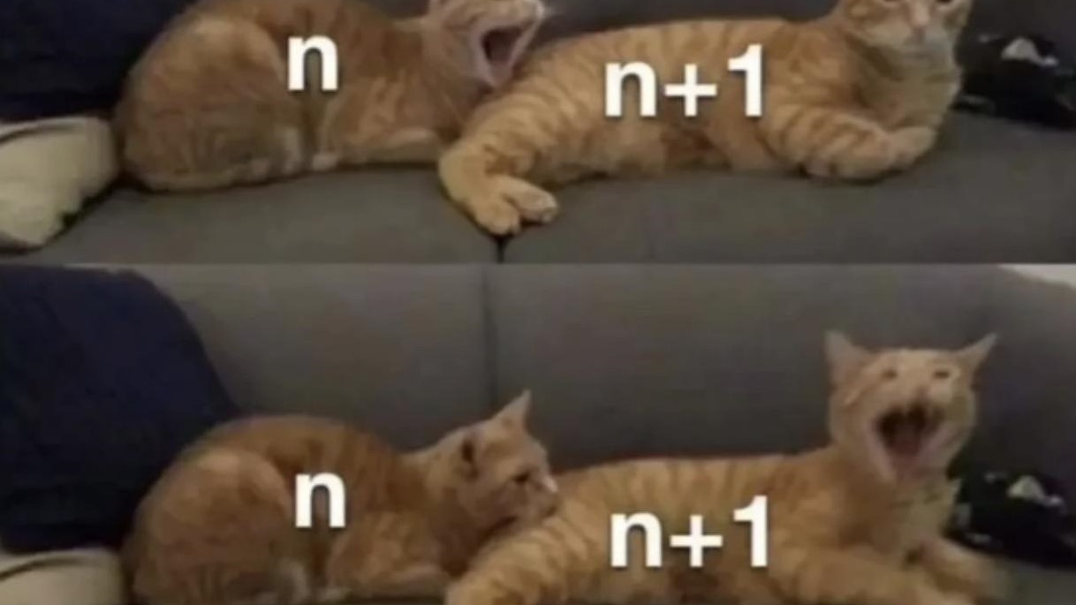
MAT102 FSG-week 8 induction!
Hans Li, Erin Wong, Farah Baseet

Slide 2
Concept check
match the general step for simple induction
Define statement:___
Prove case ____ is true
Assume ____ is true
Prove case ___ is true
Conclude that ___ is true
P(k)
P(n)
P(1)
P(n)
P(k + 1)

Slide 3
Tips for solving induction questions
Play with P(n) before starting to prove it
Make sure you remember the proof structure (important!)
Observe the difference between P(k) and P(k + 1) and see how can you use it. (in most cases substitution)

Slide 4
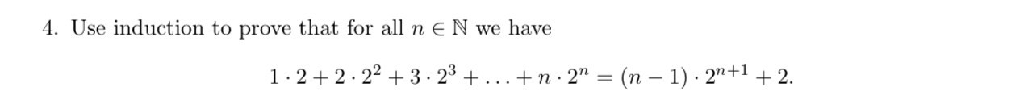
Practice: simple induction
Source: 2020 term test fall

Slide 5
Practice: simple induction
Parse through:
What's base case?
How to use P(k) to prove P(k+1)?

Slide 6
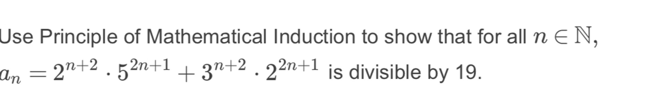
Practice: simple induction
Source: 2020 term test fall

Slide 7
Practice: simple induction
Parse through:
What's base case?
How to use P(k) to prove P(k+1)?
What has changed from P(k) to P(k + 1) and how to use it?

Slide 8
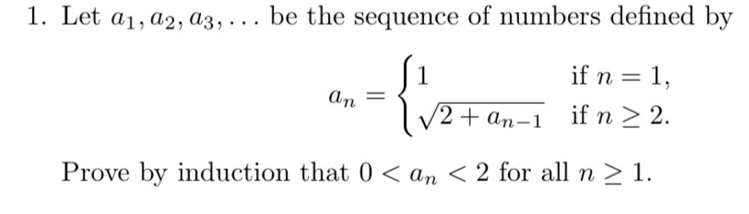
Practice: simple induction
Source: 2021 quiz 4 fall

Slide 9
Practice: simple induction
Parse through:
Is there something in proof structure that NEED to be stated to avoid part mark deduction? WHY？

Slide 10


An expansion on simple induction: notations
Identify the following notation and what they do

Slide 11
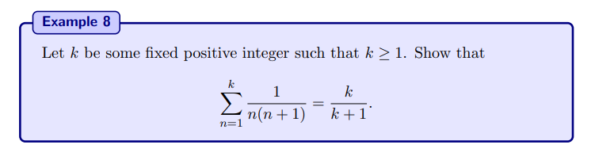
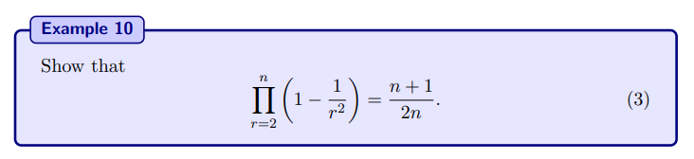
An expansion on simple induction: notations
Try use induction to proof that:
These are from your readings

Slide 12
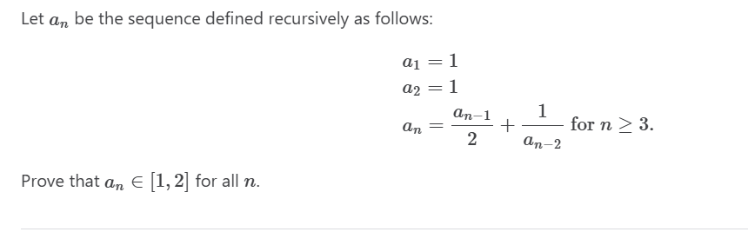
Practice: strong induction
Source: 2023 assignment 4

Slide 13
Reflection
Why must we use strong induction?
Recall 3rd practice q, why can we use simple induction?
What structure MUST we follow for strong induction?

Slide 14
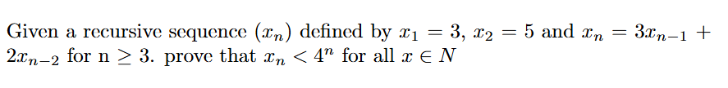
Practice: strong induction
Source: 2024 quiz 3

Slide 15
Practice: strong induction
Parse through:
P(k + 1) looks weird, how to show its true?

Slide 16

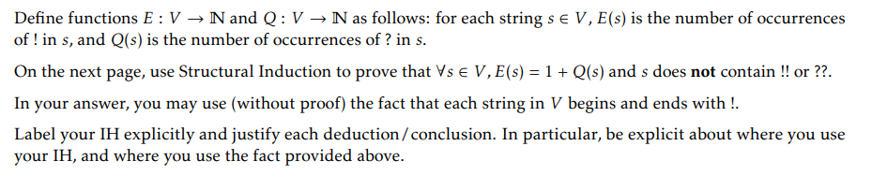
Structure induction
Source: 2024 utsg quiz2

Slide 17
Structure induction
Hint: play with the examples!

Slide 18
Challenge!
Source: 2023 assignment 4

Slide 19
THE END

